Slide 1


CMR TECHNICAL CAMPUS UGC (Autonomous) Kandlakoya , Medchal Road, Hyd-501 401 Department of Computer Science and Engineering
Mini Project Review
Robust and Secure Data Transmission Using Artificial Intelligence Techniques in Ad-Hoc Networks
BATCH NO-17
Presented by:
217R1A05K8 : A . Amulya
217R1A05K7 : AJV . Swaroop
217R1A05P5 : P . Arun Teja
Project Guide:
Dr. G. Madhukar
Associate Professor, CSE Department
Project Coordinator:
Dr . J . Narsimha Rao
Associate Professor, CSE Department

Slide 2
ABSTRACT
It presents a new security aspect for a Mobile Ad-Hoc Network (MANET)-based IoT model using the concept of artificial intelligence.
The Black Hole Attack (BHA) is considered one of the most affecting threats in the MANET in which the attacker node drops the entire data traffic and hence degrades the network performance.
Therefore, it necessitates the designing of an algorithm that can protect the network from the BHA node.
Ad-hoc On-Demand Distance Vector (AODV), a new updated routing protocol that combines the advantages of the Artificial Bee Colony (ABC), Artificial Neural Network (ANN), and Support Vector Machine (SVM) techniques.
Here, the model is trained using ANN but the selection of training data is performed using the ABC fitness function followed by SVM.
The role of ABC is to provide a better route for data transmission between the source and the destination node.

Slide 3
EXISTING SYSTEM
In the CL-PRE(certificateless proxy re-encryption) scheme, the data owner encrypts the data with the symmetric key. Subsequently, the symmetric key is encrypted with the public key of the data owner.
Both the encrypted data and the key are uploaded to the cloud. The encrypted key is re-encrypted by the cloud and becomes decryptable by the user’s private key.
The user’s identity is used to generate the public–private key pair.
The proxy re-encryption is based on bilinear pairing .The computational cost of the bilinear pairing is high as compared with the standard operations in finite fields.

Slide 4
DISADVANTAGES OF EXISTING SYSTEM
Energy Consumption
Scalability Issues
Trust and privacy issues
Cost of Deployment
Slow Decision Making
Difficulty in Training
Dependency on Proxy availability
Limited Flexibility

Slide 5
PROPOSED SYSTEM
In this proposed system, we proposed the optimized route, suggested by ABC, is then passed to the SVM model along with the node’s properties.
Based on those properties, ANN decides whether the node is a normal or an attacker node.
The simulation analysis performed in software application shows that the proposed work exhibits an improvement in terms of Packet Delivery Ratio (PDR), throughput, and delay.
To validate the system efficiency, a comparative analysis is performed against the existing approaches such as Decision Tree and Random Forest.
It indicate that the utilization of the SVM with ANN is a beneficial step regarding the detection of BHA attackers in the MANET-based IoT networks.

Slide 6
ADVANTAGES OF PROPOSED SYSTEM
Real-Time decision making
Energy efficiency
Load Balancing
Security
Self learning capabilities
Improved Reliability
Robust against attacks
Improved user privacy

Slide 7
HARDWARE REQUIREMENTS
System : Pentium IV 2.4 GHz
Hard Disk : 40 GB
RAM : 4GB
SOFTWARE REQUIREMENTS
Operating System : Windows 8 or above
Coding Language : python 3.7.0

Slide 8
Novelty Of Project
The use of artificial intelligence (AI) in ad hoc networks introduces several novel approaches for ensuring robust and secure data transmission.
AI-driven algorithms can optimize routing by predicting the most efficient paths in dynamic and decentralized environments, minimizing latency and improving reliability.
In terms of security, AI enhances encryption techniques and providing real-time protection against attacks through dynamic security protocols.
Additionally, AI enables the network to self-heal by autonomously rerouting data in case of node failures, while also optimizing energy consumption and prolonging the lifespan of devices.
Unlike traditional approaches, AI-driven systems can predict optimal routes by learning from network traffic patterns, ensuring reliable data delivery even as network topologies change.

Slide 9
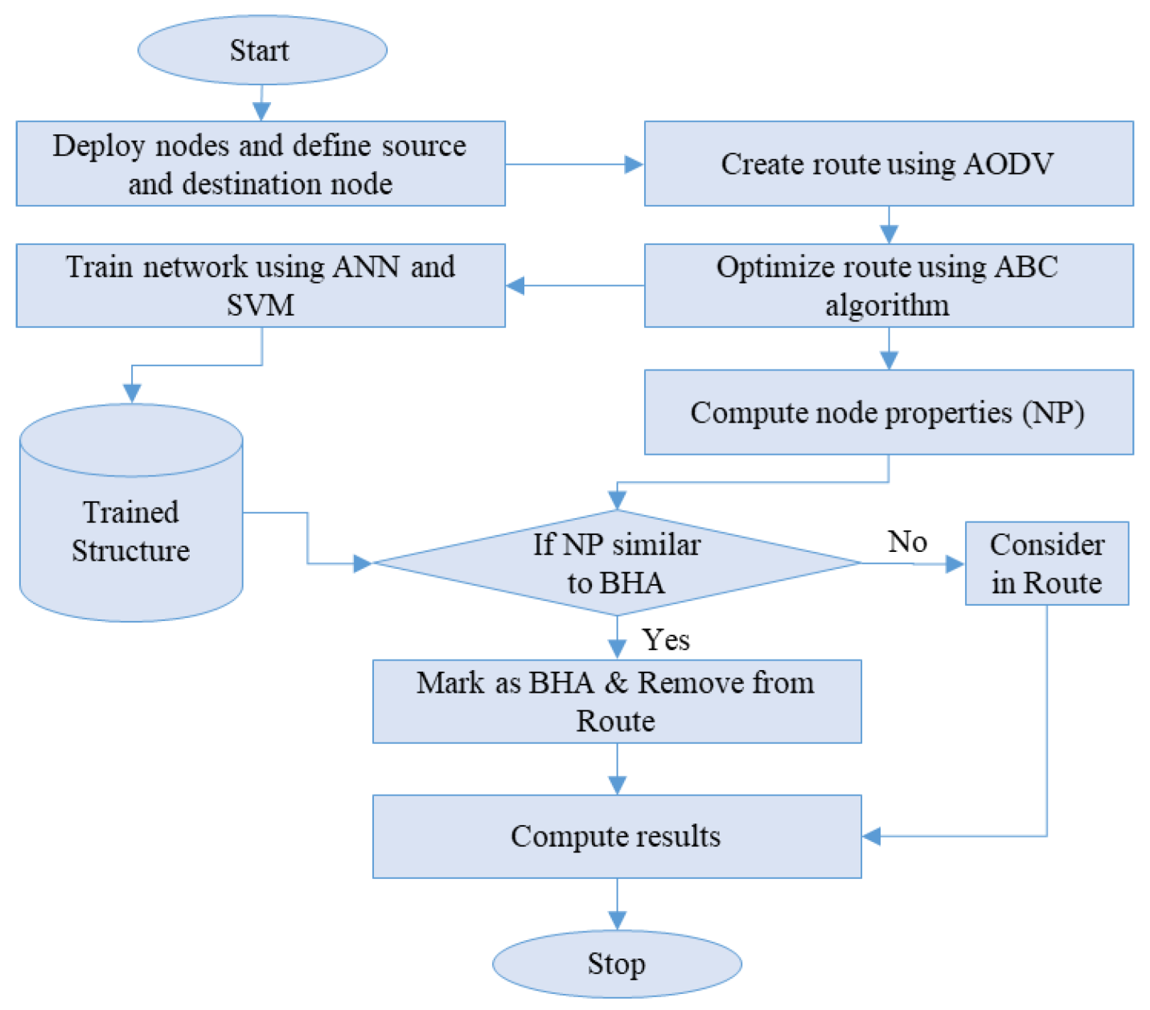
SYSTEM ARCHITECTURE

Slide 10
MODULES
Upload AODV Dataset
Preprocess Dataset
Run Propose ABC,SVM & ANN Model
Run Random Forest Algorithm
Run Decision Tree Algorithm
Comparision Graph
Attack Detection from Test Data

Slide 11
Upload AODV Dataset
when implementing AI for Robust and secure transmission datasets collected from AODV’s behavior under various conditions can help train AI models.
Preprocess Dataset
The data preprocessing module prepares raw data for further analysis . It handles data cleaning , data normalisation , data encryption . It ensures that data is clean , secure.
Run Propose ABC,SVM & ANN Model
By combining these AI techniques, the network can dynamically adjust to changing conditions, ensuring that data is transmitted securely and efficiently, even in the presence of attacks.
Run Random Forest Algorithm
The Random Forest algorithm is a powerful learnig method,can be effectively applied to it . It works by building multiple decision trees and combining their outputs to make accurate predictions.

Slide 12
Run Decision Tree Algorithm
A decision tree splits data into branches based on feature values, helping the network make real-time decisions about optimal and secure transmission routes.
Comparision Graph
It is used to compare the performance of different AI algorithms applied to it. It helps to analyze the effectiveness of various models like ABC, SVM, ANN, Decision Tree, Random Forest based on key factors such as security, transmission reliability and energy efficiency.
Attack Detection from Test Data
It is crucial for identifying malicious activity in ad-hoc networks to ensure secure data transmission. Using AI models like SVM, Decision Trees, or Random Forests, this module can classify network behavior as normal.

Slide 13
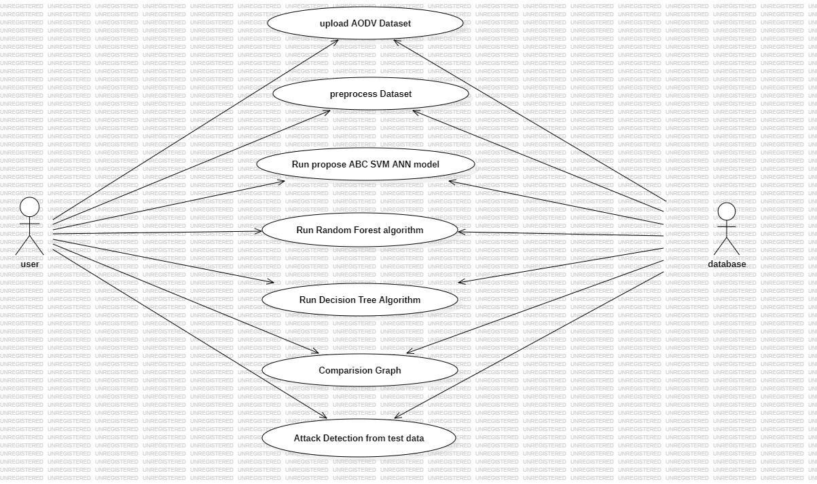
USE CASE DIAGRAM

Slide 14
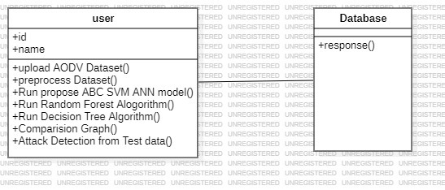
CLASS DIAGRAM

Slide 15
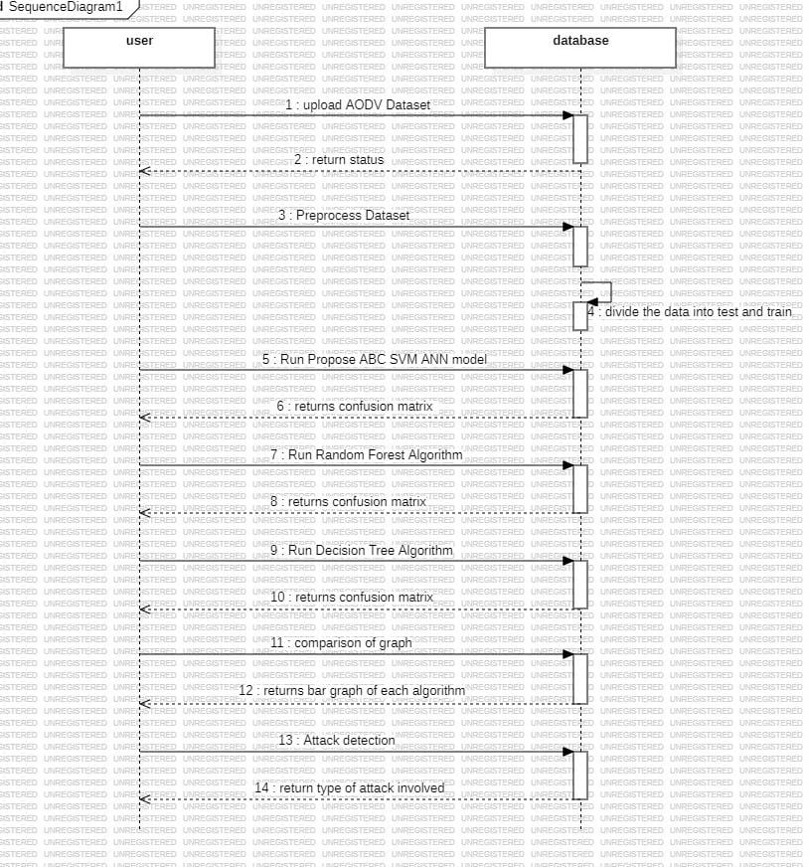
SEQUENCE DIAGRAM

Slide 16
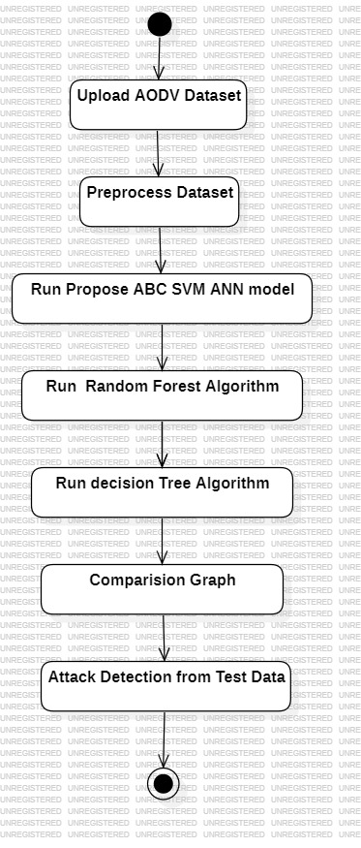
ACTIVITY DIAGRAM

Slide 17
Sample Code
from tkinter import *
import tkinter
from tkinter import filedialog
from tkinter.filedialog import askopenfilename
import seaborn as sns
from sklearn.metrics import accuracy_score
from sklearn.model_selection import train_test_split
from sklearn.metrics import precision_score
from sklearn.metrics import recall_score
from sklearn.metrics import f1_score
from sklearn.metrics import confusion_matrix
from sklearn.ensemble import RandomForestClassifier
from sklearn.tree import DecisionTreeClassifier
import os

Slide 18
import pandas as pd
import numpy as np
from sklearn.preprocessing import LabelEncoder
from sklearn.preprocessing import MinMaxScaler
from sklearn.model_selection import train_test_split
import matplotlib.pyplot as plt
from ABC import ABC
from SwarmPackagePy import testFunctions as tf
from sklearn.svm import SVC
from keras.models import Sequential
from keras.layers.core import Dense,Activation,Dropout, Flatten
from keras.utils.np_utils import to_categorical
from keras.callbacks import ModelCheckpoint
import os
import pickle

Slide 19
main = tkinter.Tk()
main.title("Robust and Secure Data Transmission Using Artificial Intelligence Techniques in Ad-Hoc Networks")
main.geometry("1200x1200")
global filename
global X, Y
global X_train, X_test, y_train, y_test
global throughput
global pdr
global delay
global classifier, class_labels, dataset, label_encoder, scaler
def uploadDataset():
global filename, class_labels, dataset
filename = filedialog.askopenfilename(initialdir="AODVDataset")
pathlabel.config(text=filename)
text.delete('1.0', END)
text.insert(END,filename+" loaded\n\n")

Slide 20
dataset = pd.read_csv(filename)
text.insert(END,str(dataset))
class_labels = np.unique(dataset['Label'])
label = dataset.groupby('Label').size()
label.plot(kind="bar")
plt.title("Different Attacks Found in Dataset Graph")
plt.xlabel("Attack Name")
plt.ylabel("Count")
plt.show()
def preprocessDataset():
global dataset, label_encoder, X, Y, X_train, X_test, y_train, y_test, scaler
text.delete('1.0', END)
dataset.fillna(0, inplace = True)
label_encoder = []
columns = dataset.columns
types = dataset.dtypes.values
for i in range(len(types)):
name = types[i]

Slide 21
if name == 'object': #finding column with object type
le = LabelEncoder()
print(columns[i])
dataset[columns[i]] = pd.Series(le.fit_transform(dataset[columns[i]].astype(str)))#encode all str columns to numeric
label_encoder.append(le)
text.insert(END,str(dataset)+"\n\n")
dataset = dataset.values
X = dataset[:,0:dataset.shape[1]-1]
Y = dataset[:,dataset.shape[1]-1]
scaler = MinMaxScaler(feature_range = (0, 1)) #use to normalize training features
X = scaler.fit_transform(X)
#function which will calculate all metrics and plot confusion matrix
def calculateMetrics(predict, y_test, algorithm):
global class_labels
p = precision_score(y_test, predict,average='macro') * 100
r = recall_score(y_test, predict,average='macro') * 100
a = accuracy_score(y_test,predict)*100

Slide 22
conf_matrix = confusion_matrix(y_test, predict)
throughput.append(a)
pdr.append(p)
delay.append(100 - r)
text.insert(END,algorithm+' Throughput : '+str(a)+"\n")
text.insert(END,algorithm+' PDR : '+str(p)+"\n")
text.insert(END,algorithm+' Delay : '+str(100 - r)+"\n\n“)
plt.figure(figsize =(6, 4))
ax = sns.heatmap(conf_matrix, xticklabels = class_labels, yticklabels = class_labels, annot = True, cmap="viridis" ,fmt ="g");
ax.set_ylim([0,len(class_labels)])
plt.title(algorithm+" Confusion matrix")
plt.ylabel('True class')
plt.xlabel('Predicted class')
plt.show()
def runPropose():
text.delete('1.0', END)
global X, Y, throughput, pdr, delay
delay = []
throughput = []
pdr = []

Slide 23
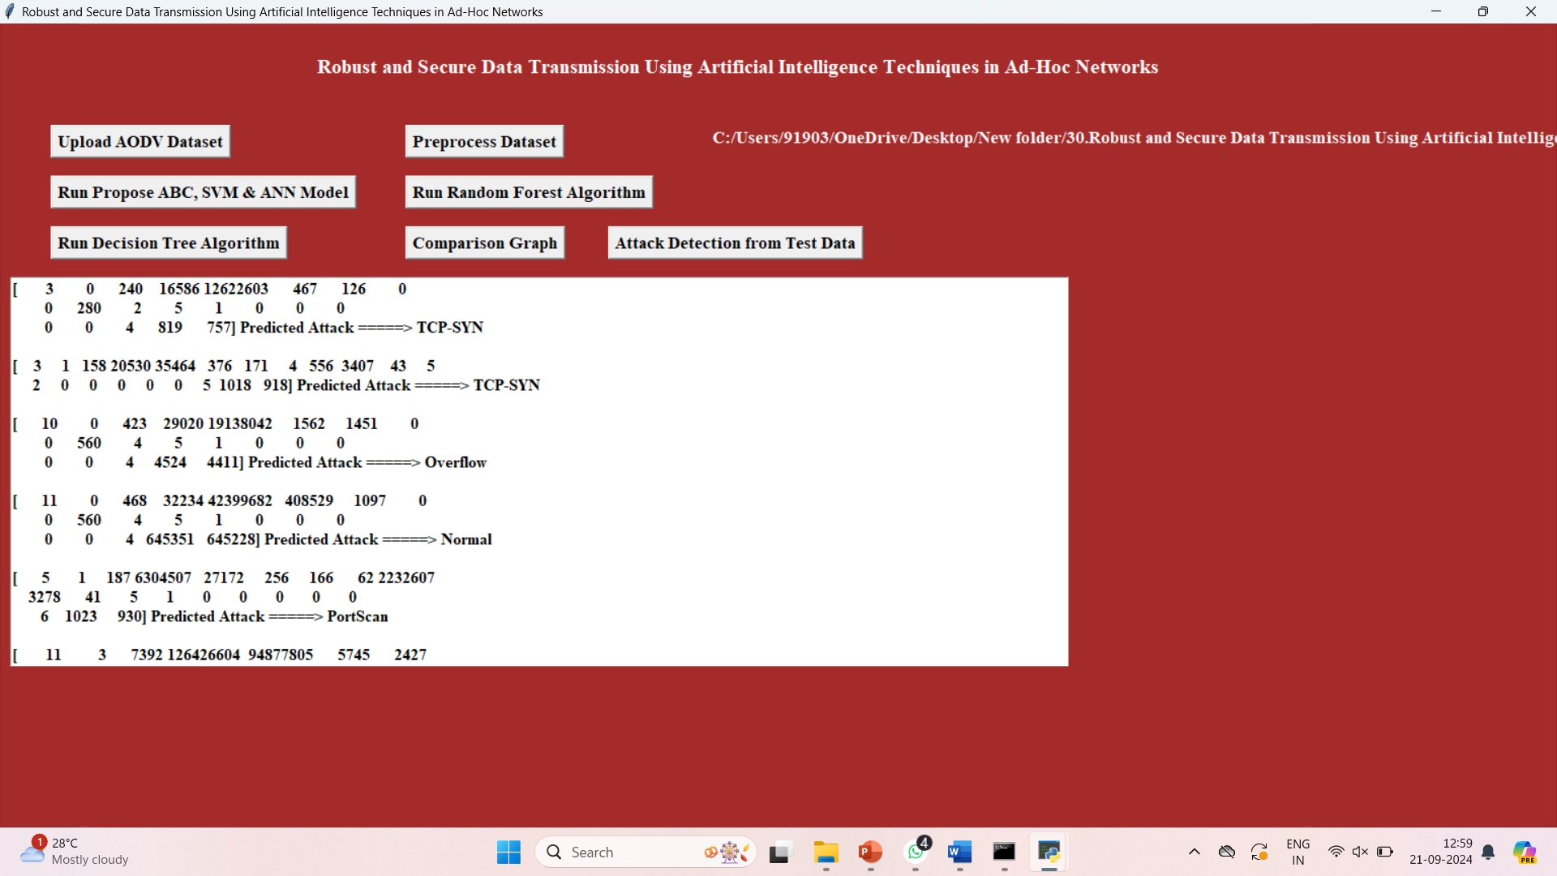
RESULT

Slide 24
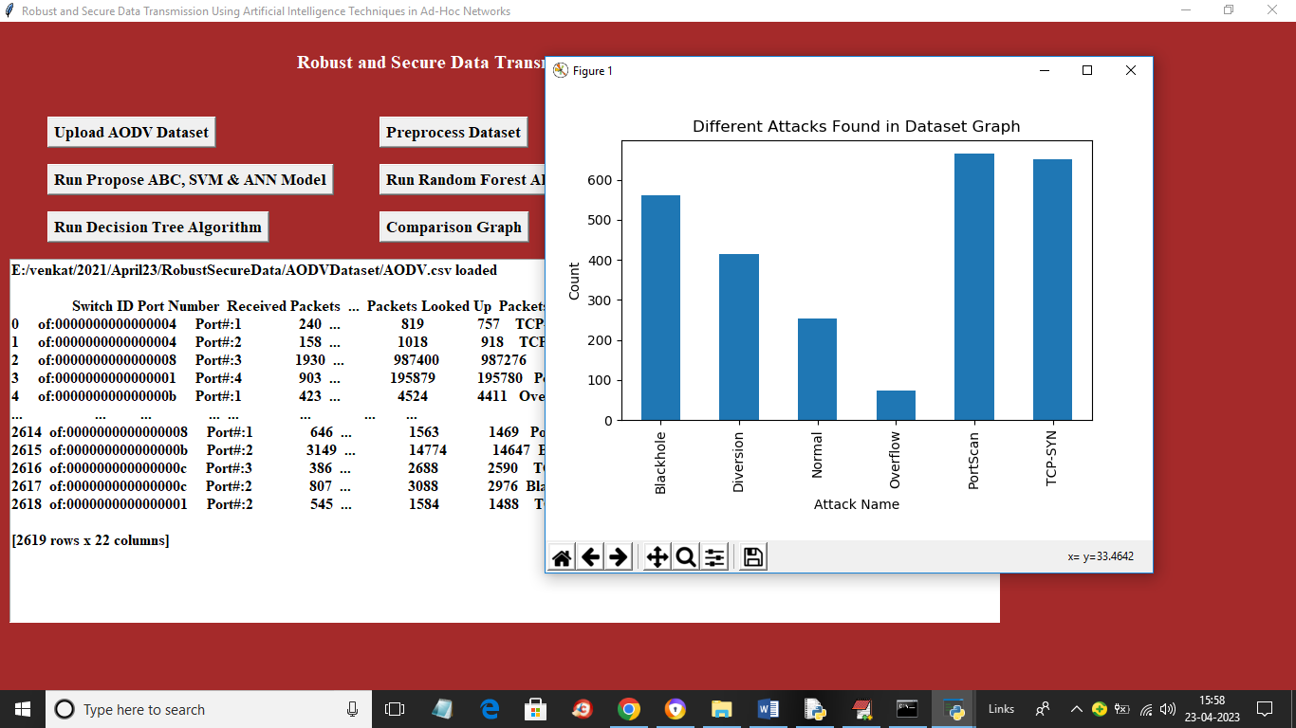
Different Attacks Found in Dataset Graph

Slide 25
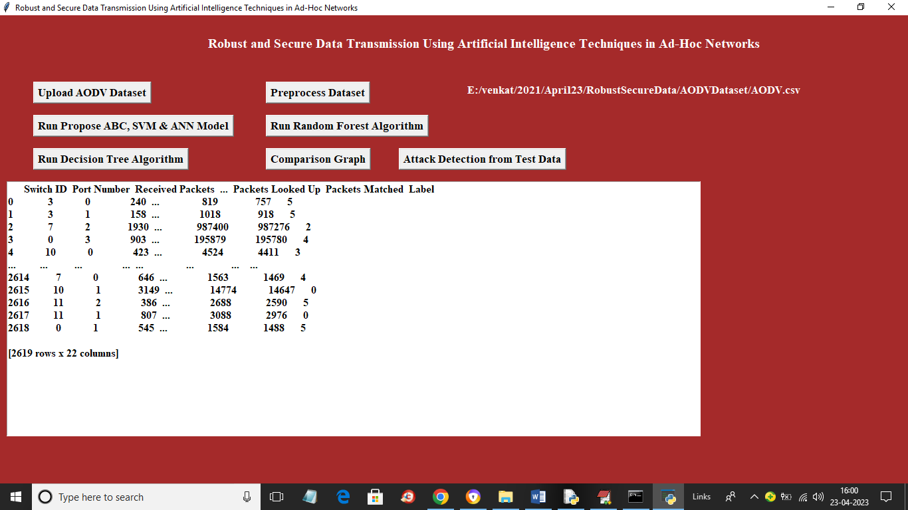
Preprocess Dataset

Slide 26
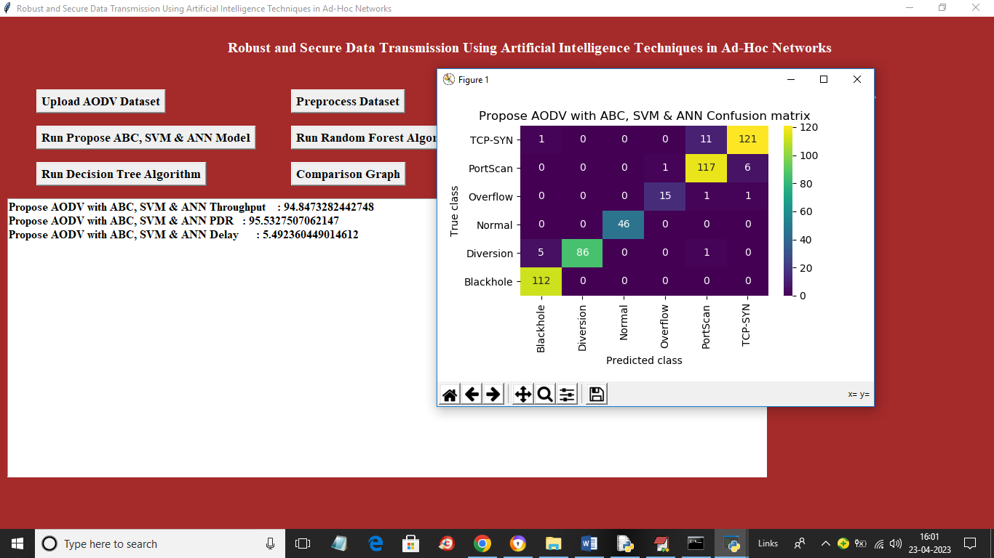
propose AODV with ABC,SVM,ANN Confusion matrix

Slide 27
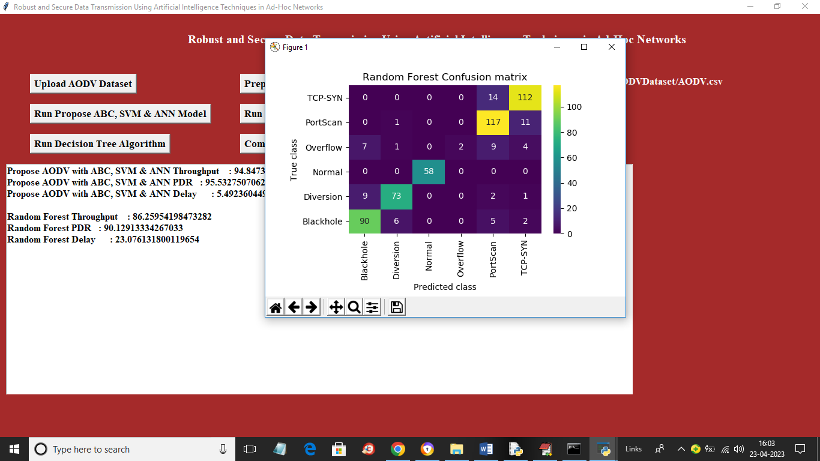
Random Forest Confusion matrix

Slide 28
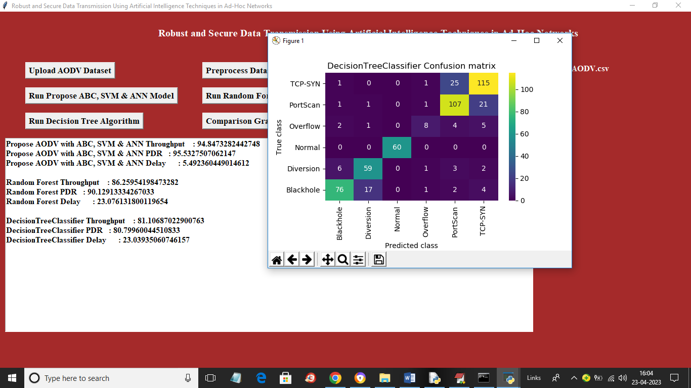
Decision Tree Classifier Confusion matrix

Slide 29
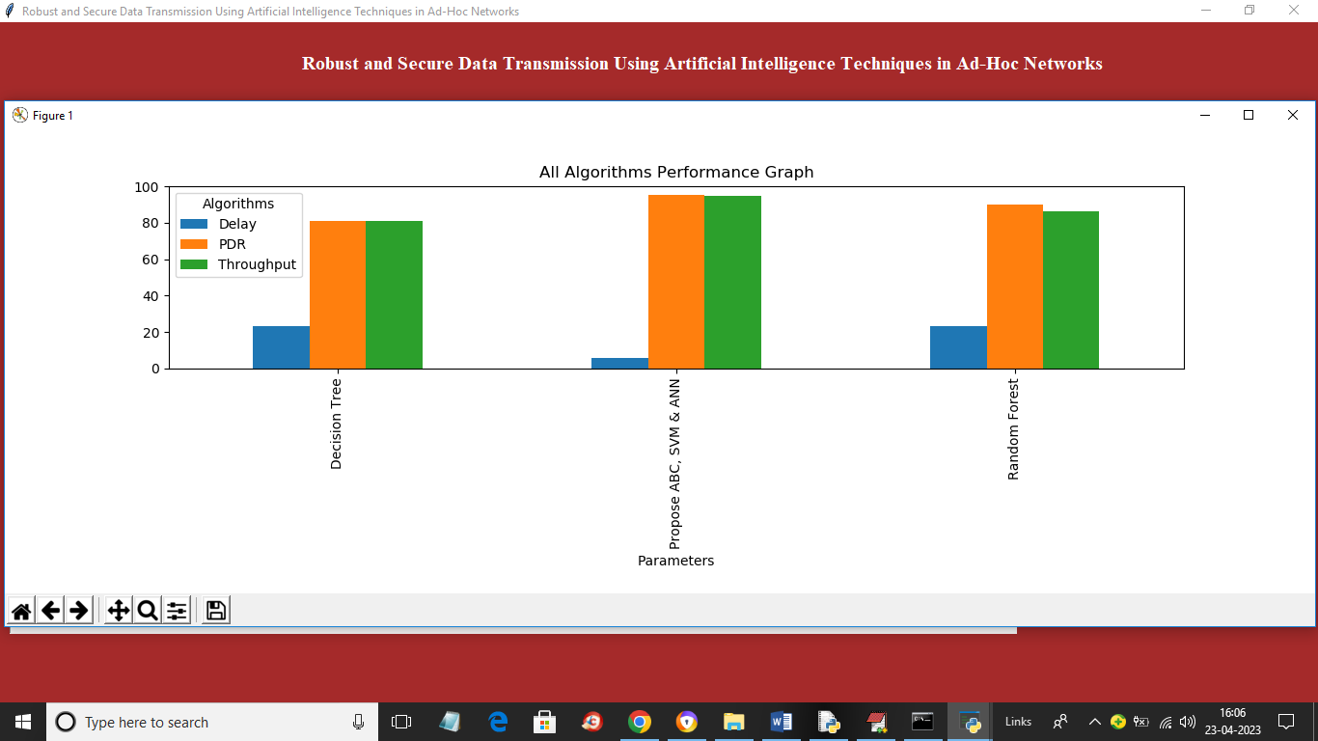
All Algorithms Performance Graph

Slide 30
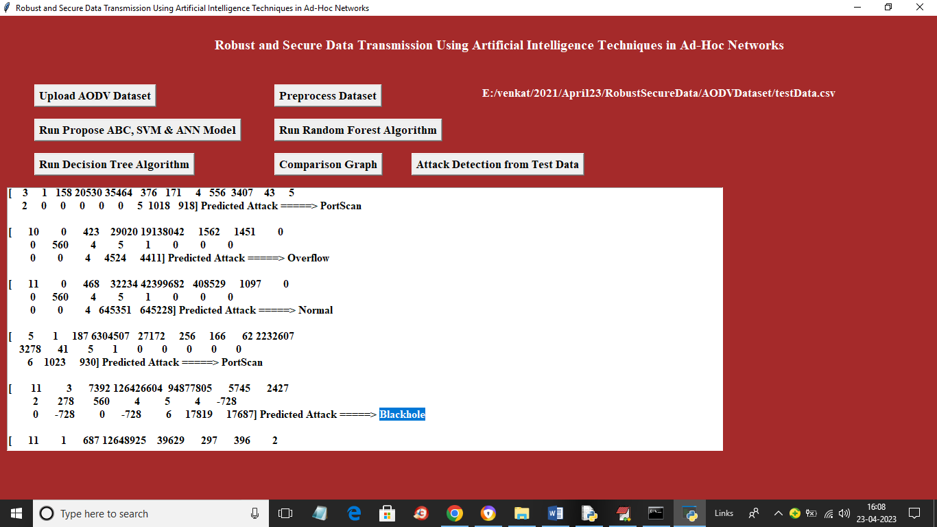
Predicted Attack Names or Normal

Slide 31
CONCLUSION
In conclusion, using artificial intelligence in ad hoc networks greatly improves secure and reliable data transmission.
AI helps detect and prevent security threats quickly, keeping data safe. It also makes data routing more efficient, reducing delays and improving overall network performance.
AI can adapt to changes in the network, making it resilient against problems or attacks.
The implementation of AI-Based solutions for robust and secure data transmission in ad-hoc networks requires careful consideration of various factors, including computational complexity, energy efficiency, scalability, and privacy preservation.
Overall, as AI technology continues to advance, it will offer even better solutions for secure and efficient data transmission in these types of networks.

Slide 32
FUTURE SCOPE
Future work can explore more advanced machine learning models, such as reinforcement learning, for more accurate threat detection, dynamic routing optimization, and improved network performance. Future iterations could include self-healing capabilities, where the network can automatically recover from node failures or attacks without human intervention, ensuring continuous service. Research into AI techniques for energy-efficient data transmission and routing can extend the battery life of mobile devices in ad-hoc networks. Exploring privacy-preserving techniques for AI-driven data transmission in ad-hoc networks. Future research should focus on developing algorithms and protocols that enable secure and confidential data transmission while preserving the privacy of users' sensitive information.

Slide 33
REFERENCES
1. A. Sethi, P. Sharma, and S. Sharma, "A Survey on Artificial Intelligence Techniques for Secure Data Transmission in Ad-Hoc Networks," International Journal of Advanced Research in Computer Science, vol. 12, no. 3, pp. 45-56, 2021.
V. Gupta and S. Jain, "Machine Learning Techniques for Enhancing Security in Ad-Hoc Networks: A Review," Wireless Personal Communications, vol. 108, no. 1, pp. 235-256, 2019.
D. Srinivasan and K. Kundan, "Secure Data Transmission Using Blockchain Technology in Ad-Hoc Networks," International Journal of Engineering and Advanced Technology, vol. 9, no. 2, pp. 466-470, 2019.
R. R. Brooks, "Adversarial Robustness in Machine Learning for Wireless Communications," IEEE Transactions on Cognitive Communications and Networking, vol. 6, no. 2, pp. 529-538, 2020.

Slide 34
THANK YOU

